Slide 1

Exam AZ-304: Microsoft Azure Architect Design Crash Course
Tim Warner

Slide 2


Tim Warner
Based in Nashville, TN, US
MCT, MVP
Twitter: @TechTrainerTim
Badge: TechTrainerTim.com

Slide 3
Day 1 of 2 Agenda
Introduction
Identity and Security Design
Storage Data Design
Monitoring Design

Slide 4
Day 2 of 2 Agenda
Content catch-up
Business Continuity Design
Infrastructure Design
Exam AZ-304 strategy

Slide 5
Course Materials
timw.info/az304

Slide 6
A Different Kind of Training
We'll learn by doing – at least 80 percent demo
Visual, case study approach
This is an expert certification, so we will move quickly and assume intermediate-level Azure skills
5-minute break at midpoint
I’m here to answer your questions – take advantage of this!
Use the Q&A panel

Slide 7

Session Recordings

Slide 8
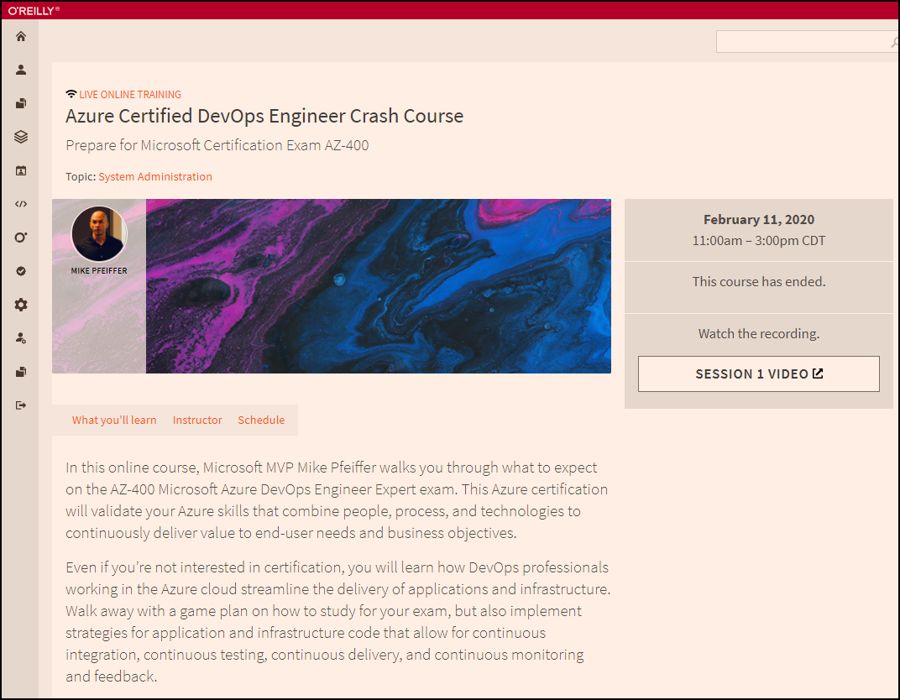
Session Recordings

Slide 9

Session Recordings

Slide 10
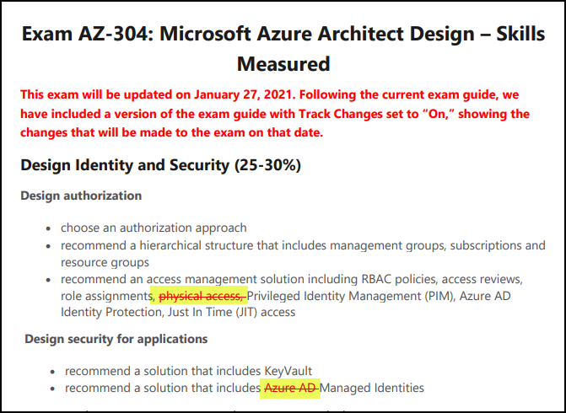
AZ-304 Changes: January 27, 2020

Slide 11
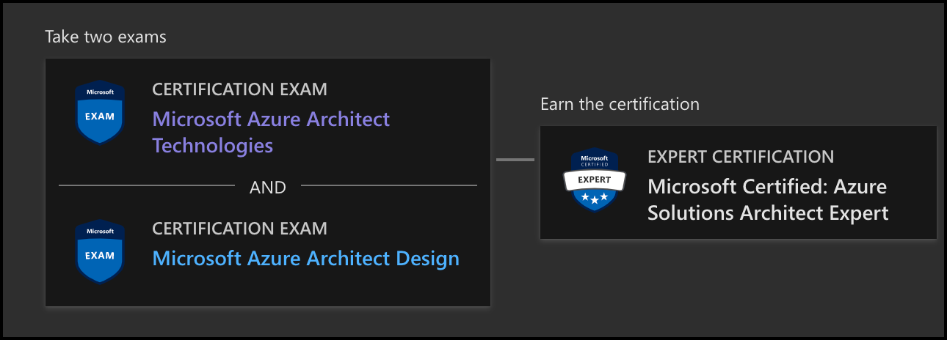
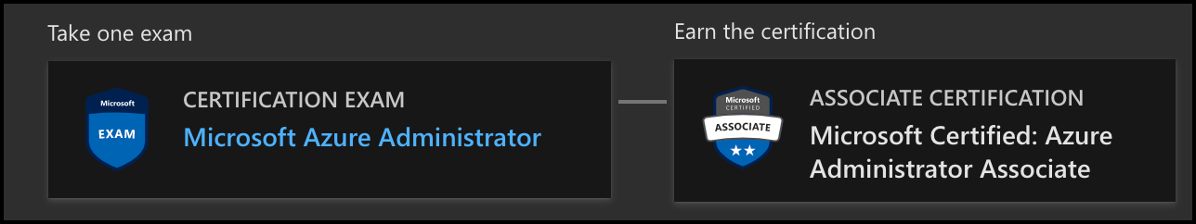
Azure Architect Certification
AZ-303
AZ-304
AZ-104

Slide 12
Tim's Certification Study Pyramid
Interdependence
Content knowledge
Practical application
Test-taking skills

Slide 13
Storage Account Replication
1
3
3
2
LRS
ZRS

Slide 14
Storage Account Replication
3
3
GRS/RA-GRS

Slide 15
Storage Account Replication
1
3
1
3
2
2
GZRS – RA/GZRS

Slide 16

Always Encrypted

Slide 17

Azure Monitor

Slide 18
Thank you!
Course materials: timw.info/az304
Twitter: @TechTrainerTim
Work: timw.info/ps
Web: TechTrainerTim.com

Slide 19
Authentication

Slide 20

Tenant vs. Subscription

Slide 21

Hybrid Identity

Slide 22

Azure AD B2C

Slide 23
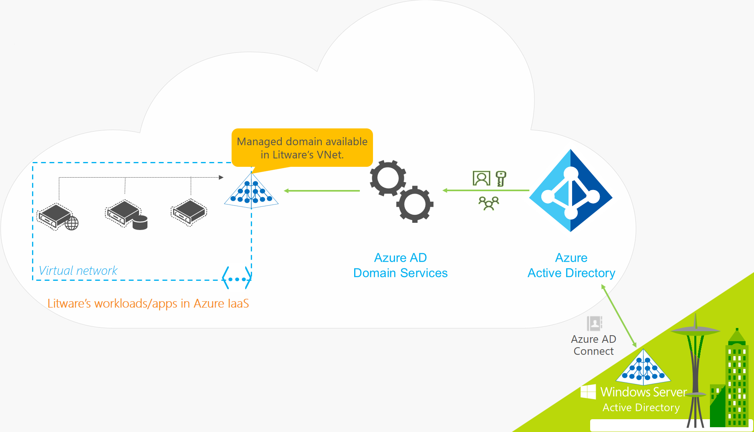
Azure AD Domain Services

Slide 24
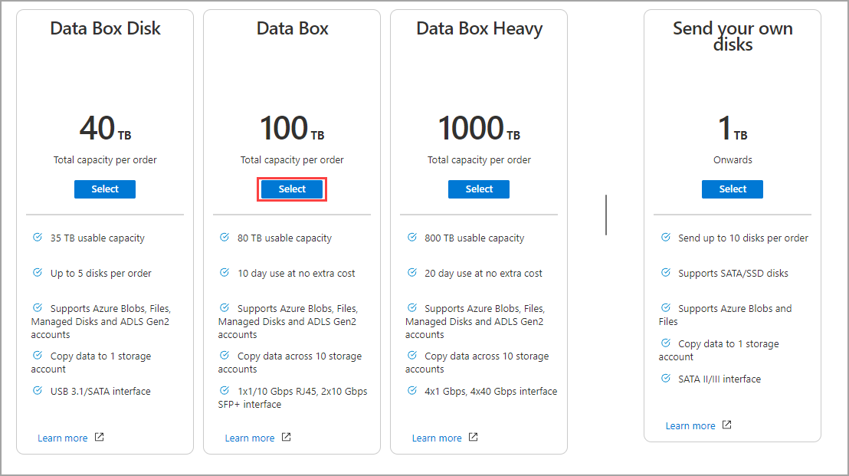
Azure Data Box

Slide 25

Passthrough Authentication

Slide 26

Seamless Single Sign-on

Slide 27
Authorization and Governance

Slide 28

Azure Management Scopes
/ Tenant Root

Slide 29
Azure Storage

Slide 30

Data Pipelines

Slide 31
Monitoring

Slide 32
Azure Diagnostics

Slide 33

Log Analytics

Slide 34

Sentinel

Slide 35
Migration and Disaster Recovery

Slide 36

Azure Backup

Slide 37

Azure Site Recovery

Slide 38
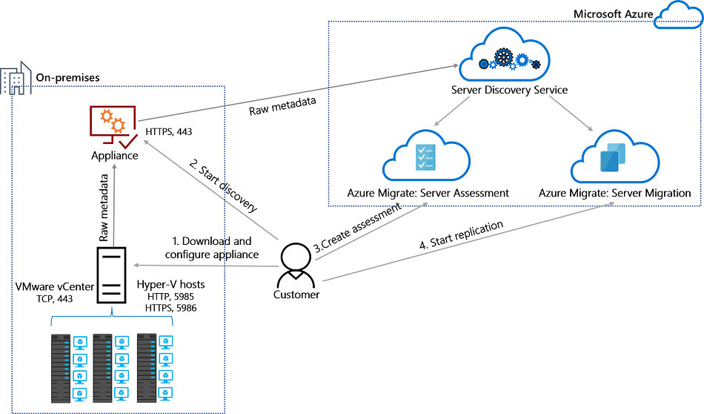
Azure Migrate

Slide 39
Azure Compute

Slide 40

VM Scale Sets

Slide 41
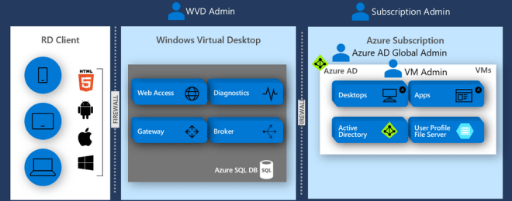
Windows Virtual Desktop (WVD)
timw.info/travis

Slide 42

Availability Set

Slide 43

Availability Zone

Slide 44
Load Balancing

Slide 45

VM Networking

Slide 46

Load Balancing

Slide 47

VNet Peering

Slide 48

Hybrid Networking

Slide 49

Network Virtual Appliance

Slide 50

Azure Load Balancer

Slide 51

Application Gateway

Slide 52

Traffic Manager

Slide 53

Front Door Service

Slide 54
Containers

Slide 55


Docker Container Lifecycle
https://timw.info/3635f

Slide 56
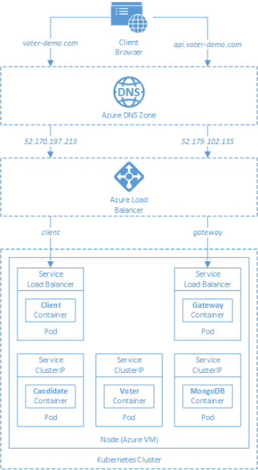
AKS

Slide 57
App Architecture

Slide 58

Event Architecture

Slide 59

Event Architecture

Slide 60
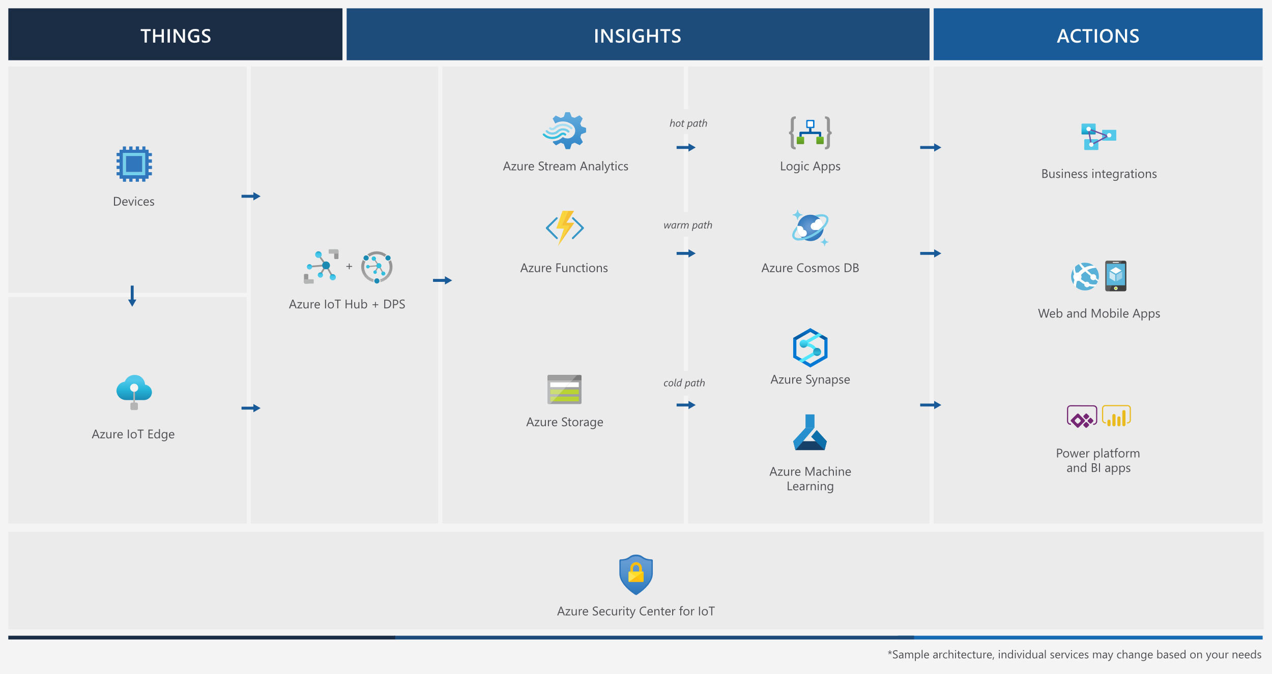
Event Architecture

Slide 61
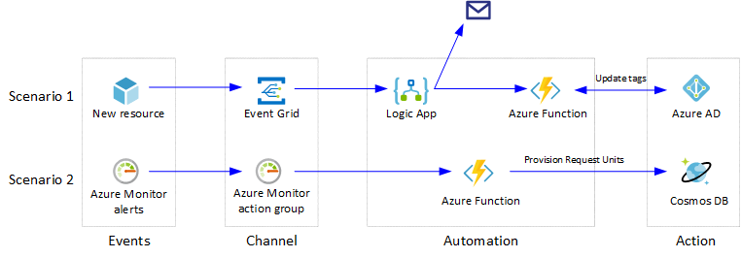
Event Architecture

Slide 62
Exam AZ-304 Item Types

Slide 63

Multiple Choice

Slide 64
Repeated Scenario
You need to move an Azure VM to another hardware host.
Solution: You redeploy the VM.
Does this solution meet the goal?
Yes
No

Slide 65

Select and Place

Slide 66

Build List and Reorder

Slide 67

Active Screen/Fill in the Blank

Slide 68

Case Study

Slide 69






Performance-Based Lab

Slide 70
Microsoft Online Testing

Slide 71
Microsoft Online Testing Process
timw.info/online

Slide 72

Microsoft Online Testing Process

Slide 73

Microsoft Online Testing Process

Slide 74

Microsoft Online Testing Process

Slide 75

Microsoft Online Testing Process

Slide 76

Microsoft Online Testing Process

Slide 77

Microsoft Online Testing Process

Slide 78

Microsoft Online Testing Process

Slide 79
AZ-304 Exam Strategy
Focus your skills accordingly:
60 percent Azure portal
20 percent Azure PowerShell
10 percent Azure CLI
10 percent KQL
Expect performance-based labs, but be thankful if you don't see 'em

Slide 80
Thank you!
Course materials: timw.info/az304
Twitter: @TechTrainerTim
Work: timw.info/ps
Web: TechTrainerTim.com

